Slide 1
DS&AI Project The Semantic web
Marcello Bonsangue
LIACS – Leiden University
m.m.bonsangue@liacs.leidenuniv.nl
Reusing slides from
Grigoris Antoniou and Frank van Harmelen

Slide 2
Outline
Today’s Web
The Semantic Web Impact
Semantic Web Technologies
A Layered Approach

Slide 3
Today’s Web
Most of today’s Web content is suitable for human consumption
Even Web content that is generated automatically from databases is usually presented without the original structural information found in databases
Typical Web uses today people’s
seeking and making use of information, searching for and getting in touch with other people, reviewing catalogs of online stores and ordering products by filling out forms

Slide 4
Keyword-Based Search Engines
Current Web activities are not particularly well supported by software tools
Except for keyword-based search engines (e.g. Google, AltaVista, Yahoo)
The Web would not have been the huge success it was, were it not for search engines

Slide 5
Problems of Keyword-Based : Search Engines
High recall, low precision.
Low or no recall
Results are highly sensitive to vocabulary
Results are single Web pages
Human involvement is necessary to interpret and combine results
Results of Web searches are not readily accessible by other software tools

Slide 6
The Key Problem of Today’s Web
The meaning of Web content is not machine-accessible: lack of semantics
It is simply difficult to distinguish the meaning between these two sentences:
I am a professor of computer science.
I am a professor of computer science,
you may think. Well, . . .

Slide 7
The Semantic Web Approach
Represent Web content in a form that is more easily machine-processable.
Use intelligent techniques to take advantage of these representations.
The Semantic Web will gradually evolve out of the existing Web, it is not a competition to the current WWW

Slide 8
Outline
Today’s Web
The Semantic Web Impact
Semantic Web Technologies
A Layered Approach

Slide 9
The Semantic Web Impact – Knowledge Management
Knowledge management concerns itself with acquiring, accessing, and maintaining knowledge within an organization
Key activity of large businesses: internal knowledge as an intellectual asset
It is particularly important for international, geographically dispersed organizations
Most information is currently available in a weakly structured form (e.g. text, audio, video)

Slide 10
Limitations of Current Knowledge Management Technologies
Searching information
Keyword-based search engines
Extracting information
human involvement necessary for browsing, retrieving, interpreting, combining
Maintaining information
inconsistencies in terminology, outdated information.
Viewing information
Impossible to define views on Web knowledge

Slide 11
Semantic Web Enabled Knowledge Management
Knowledge will be organized in conceptual spaces according to its meaning.
Automated tools for maintenance and knowledge discovery
Semantic query answering
Query answering over several documents
Defining who may view certain parts of information (even parts of documents) will be possible.

Slide 12
The Semantic Web Impact – B2C Electronic Commmerce
A typical scenario: user visits one or several online shops, browses their offers, selects and orders products.
Ideally humans would visit all, or all major online stores; but too time consuming
Shopbots are a useful tool

Slide 13
Limitations of Shopbots
They rely on wrappers: extensive programming required
Wrappers need to be reprogrammed when an online store changes its outfit
Wrappers extract information based on textual analysis
Error-prone
Limited information extracted

Slide 14
Semantic Web Enabled B2C - Electronic Commerce
Software agents that can interpret the product information and the terms of service.
Pricing and product information, delivery and privacy policies will be interpreted and compared to the user requirements.
Information about the reputation of shops
Sophisticated shopping agents will be able to conduct automated negotiations

Slide 15
The Semantic Web Impact – B2B Electronic Commerce
Greatest economic promise
Currently relies mostly on EDI
Isolated technology, understood only by experts
Difficult to program and maintain, error-prone
Each B2B communication requires separate programming
Web appears to be perfect infrastructure
But B2B not well supported by Web standards

Slide 16
Semantic Web Enabled B2B Electronic Commerce
Businesses enter partnerships without much overhead
Differences in terminology will be resolved using standard abstract domain models
Data will be interchanged using translation services.
Auctioning, negotiations, and drafting contracts will be carried out automatically (or semi-automatically) by software agents

Slide 17
Wikis
Collections of web pages that allow users to add content via a browser interface
Wiki systems allow for collaborative knowledge
Users are free to add and change information without ownership of content, access restrictions, or rigid workflows

Slide 18
Some Uses of Wikis
Development of bodies of knowledge in a community effort, with contributions from a wide range of users (e.g. Wikipedia)
Knowledge management of an activity or a project (e.g. brainstorming and exchanging ideas, coordinating activities, exchanging records of meetings)

Slide 19
Semantic Web Enabled Wikis
The inherent structure of a wiki, given by the linking between pages, gets accessible to machines beyond mere navigation
Structured text and untyped hyperlinks are enriched by semantic annotations referring to an underlying model of the knowledge captured by the wiki
e.g. a hyperlink from Knossos to Heraklion could be annotated with information is located in. This information could then be used for context-specific presentations of pages, advanced querying, and consistency verification

Slide 20
Outline
Today’s Web
The Semantic Web Impact
Semantic Web Technologies
A Layered Approach

Slide 21
Semantic Web Technologies
Explicit Metadata
Ontologies
Logic and Inference
Agents

Slide 22
On HTML
Web content is currently formatted for human readers rather than programs
HTML is the predominant language in which Web pages are written (directly or using tools)
Vocabulary describes presentation

Slide 23
An HTML Example
<h1>Agilitas Physiotherapy Centre</h1>
Welcome to the home page of the Agilitas Physiotherapy Centre. Do
you feel pain? Have you had an injury? Let our staff Lisa Davenport,
Kelly Townsend (our lovely secretary) and Steve Matthews take care
of your body and soul.
<h2>Consultation hours</h2>
Mon 11am - 7pm<br>
Tue 11am - 7pm<br>
Wed 3pm - 7pm<br>
Thu 11am - 7pm<br>
Fri 11am - 3pm<p>
But note that we do not offer consultation during the weeks of the
<a href=". . .">State Of Origin</a> games.

Slide 24
Problems with HTML
Humans have no problem with this
Machines (software agents) do:
How distinguish therapists from the secretary,
How determine exact consultation hours
They would have to follow the link to the State Of Origin games to find when they take place.

Slide 25
A Better Representation
<company>
<treatmentOffered>Physiotherapy</treatmentOffered>
<companyName>Agilitas Physiotherapy Centre</companyName>
<staff>
<therapist>Lisa Davenport</therapist>
<therapist>Steve Matthews</therapist>
<secretary>Kelly Townsend</secretary>
</staff>
</company>

Slide 26
Explicit Metadata
This representation is far more easily processable by machines
Metadata: data about data
Metadata capture part of the meaning of data
Semantic Web does not rely on text-based manipulation, but rather on machine-processable metadata

Slide 27
Ontologies
The term ontology originates from philosophy
The study of the nature of existence
Different meaning from computer science
An ontology is an explicit and formal specification of a conceptualization

Slide 28
Typical Components of Ontologies
Terms denote important concepts (classes of objects) of the domain
e.g. professors, staff, students, courses, departments
Relationships between these terms: typically class hierarchies
a class C to be a subclass of another class C' if every object in C is also included in C'
e.g. all professors are staff members

Slide 29
Further Components of Ontologies
Properties:
e.g. X teaches Y
Value restrictions
e.g. only faculty members can teach courses
Disjointness statements
e.g. faculty and general staff are disjoint
Logical relationships between objects
e.g. every department must include at least 10 faculty

Slide 30
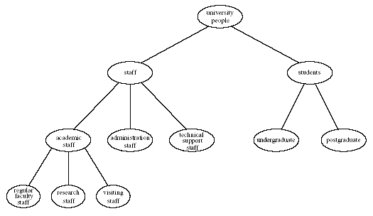
Example of a Class Hierarchy

Slide 31
The Role of Ontologies on the Web
Ontologies provide a shared understanding of a domain: semantic interoperability
overcome differences in terminology
mappings between ontologies
Ontologies are useful for the organization and navigation of Web sites

Slide 32
The Role of Ontologies in Web Search
Ontologies are useful for improving the accuracy of Web searches
search engines can look for pages that refer to a precise concept in an ontology
Web searches can exploit generalization/ specialization information
If a query fails to find any relevant documents, the search engine may suggest to the user a more general query.
If too many answers are retrieved, the search engine may suggest to the user some specializations.

Slide 33
Web Ontology Languages
RDF Schema
RDF is a data model for objects and relations between them
RDF Schema is a vocabulary description language
Describes properties and classes of RDF resources
Provides semantics for generalization hierarchies of properties and classes

Slide 34
Web Ontology Languages (2)
OWL
A richer ontology language
relations between classes
e.g., disjointness
cardinality
e.g. “exactly one”
richer typing of properties
characteristics of properties (e.g., symmetry)

Slide 35
Logic versus Ontologies
Logic can be used to uncover ontological knowledge that is implicitly given
It can also help uncover unexpected relationships and inconsistencies
Logic is more general than ontologies
It can also be used by intelligent agents for making decisions and selecting courses of action

Slide 36
Tradeoff between Expressive Power and Computational Complexity
The more expressive a logic is, the more computationally expensive it becomes to draw conclusions
Drawing certain conclusions may become impossible if non-computability barriers are encountered.
Our previous examples involved rules “If conditions, then conclusion,” and only finitely many objects
This subset of logic is tractable and is supported by efficient reasoning tools

Slide 37
Inference and Explanations
Explanations: the series of inference steps can be retraced
They increase users’ confidence in Semantic Web agents: “Oh yeah?” button
Activities between agents: create or validate proofs

Slide 38
Typical Explanation Procedure
Facts will typically be traced to some Web addresses
The trust of the Web address will be verifiable by agents
Rules may be a part of a shared commerce ontology or the policy of the online shop

Slide 39
Software Agents
Software agents work autonomously and proactively
They evolved out of object oriented and compontent-based programming
A personal agent on the Semantic Web will:
receive some tasks and preferences from the person
seek information from Web sources, communicate with other agents
compare information about user requirements and preferences, make certain choices
give answers to the user

Slide 40
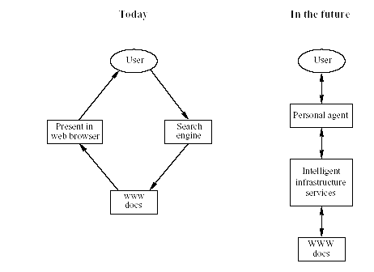
Intelligent Personal Agents

Slide 41
Semantic Web Agent Technologies
Metadata
Identify and extract information from Web sources
Ontologies
Web searches, interpret retrieved information
Communicate with other agents
Logic
Process retrieved information, draw conclusions

Slide 42
Semantic Web Agent Technologies (2)
Further technologies (orthogonal to the Semantic Web technologies)
Agent communication languages
Formal representation of beliefs, desires, and intentions of agents
Creation and maintenance of user models.

Slide 43
Outline
Today’s Web
The Semantic Web Impact
Semantic Web Technologies
A Layered Approach

Slide 44
A Layered Approach
The development of the Semantic Web proceeds in steps
Each step building a layer on top of another
Principles:
Downward compatibility
Upward partial understanding

Slide 45
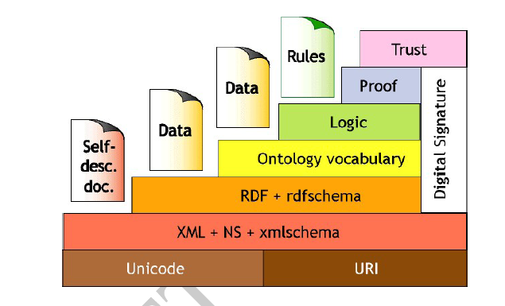
The Semantic Web Layer Tower

Slide 46
An Alternative Layer Stack
Takes recent developments into account
The main differences are:
The ontology layer is instantiated with two alternatives: the current standard Web ontology language, OWL, and a rule-based language
DLP is the intersection of OWL and Horn logic, and serves as a common foundation
The Semantic Web Architecture is currently being debated and may be subject to refinements and modifications in the future.

Slide 47
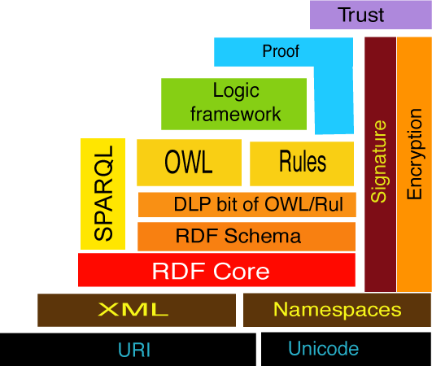
Alternative Semantic Web Stack

Slide 48
Semantic Web Layers
XML layer
Syntactic basis
RDF layer
RDF basic data model for facts
RDF Schema simple ontology language
Ontology layer
More expressive languages than RDF Schema
Current Web standard: OWL

Slide 49
Semantic Web Layers (2)
Logic layer
enhance ontology languages further
application-specific declarative knowledge
Proof layer
Proof generation, exchange, validation
Trust layer
Digital signatures
recommendations, rating agencies ….

